Slide 1
Resource Hints
Helping the browser make better decisions

Slide 2
Presentation Summary
What are resource hints?
What resource hints are there?
Hints inside of hints
When to use resource hints?

Slide 3
1. What are resource hints?

Slide 4
What are resource hints?
They allow us to help the browser find the resources it will need and download them ahead of time for better performance
If a browser doesn’t support resource hints, it will simply ignore them so your web page will still load normally

Slide 5
2. What resource hints are there?

Slide 6
What resource hints are there?
There are 5 resource hints that can be grouped accordingly:
Domain-specific | Resource-specific | Page-Specific
dns-prefetch | prefetch | prerender
preconnect | preload | -

Slide 7
dns-prefetch

Slide 8
What resource hints are there? dns-prefetch
dns-prefetching is the process of initiating the DNS resolution of each domain where a site has hosted resources, before the browser may make a request for them. The goal being to save the time involved in resolving the DNS when the resource is actually needed on the page.
DNS resolution only affects the first resource downloaded from that domain, but it still matters. If you perform a DNS resolution in advance, you’ll save that time and load that resource faster.
Notes:
dns-prefetch allows the browser to make the first step in downloading a resource it may need from a domain.

Slide 9
dns-prefetch: Benefits
DNS resolution occurs in the background
Saves time when a resource is requested from a new, external domain (20-120ms)
Lightweight expense versus opening/keeping connection
You can be more liberal in its usage without a great performance hit
Initiate resolution of resources the browser will not be aware of when parsing page
Strong browser support in terms of breadth and depth (i.e. IE9)

Slide 10
dns-prefetch: Be aware of
The browser is not required to follow a <link rel=“dns-prefetch”> instruction
Pages that use resources must still have <link>’s to those resources
Using both the dns-prefetch and preconnect tags for the same domain is not useful as preconnect does everything dns-prefetch does and more
Exceptions:
You want to support older browsers (see caniuse.com charts that follow)
You want to speed up more than 4 domains without the expense of opening and keeping a connection

Slide 11
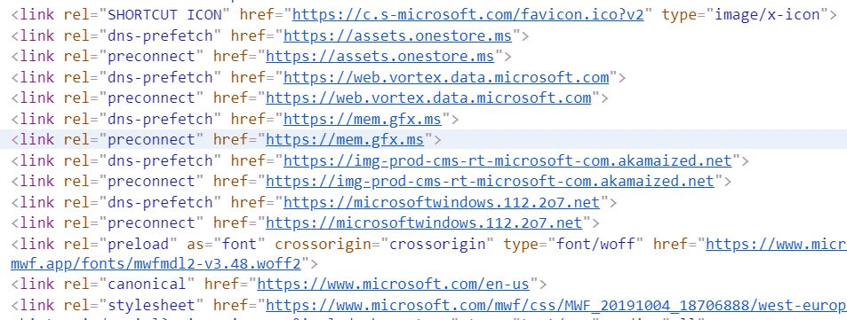
dns-prefetch: dns-prefetch, preconnect Exception Example
Notes:
Example from inspecting the source code for Microsoft.com, which contains five pairs of dns-prefetch/preconnect hints. This likely is to make use of support of Microsoft’s IE9 browser, which is too old to support preconnect hints, but can act on dns-prefetch hints.

Slide 12
dns-prefetch: How it works
<link rel=“dns-prefetch” href=“//example.com”>
Hint Encountered
The browser first checks its cache for the domain
Cached copy not found
Request occurs in background
Cache primed
DNS resolved ahead of connecting to domain
Domain cached
Notes:
When the browser encounters this hint, it first checks its DNS Cache and then lacking a cached copy resolves the domain to the associated IP address through a request from the DNS server.
These requests happen in the background in a way that doesn’t block the rendering of the page.

Slide 13






dns-prefetch: Example – JavaScript Issue
DNS resolution occurs at runtime
my-app.com
Local DNS cache
api.my-app.com
DNS Resolution
User action occurs
3
1
2
Local DNS cache
api.my-app.com
4
5
api.my-app.com
JavaScript file makes AJAX requests to api.my-app.com based on user action
6
Notes:
While doing speculative parsing, the browser does not execute inline JavaScript blocks. This means that it won’t discover any script-injected resources while parsing the page.
In this example, the app is hosted at my-app.com, and it makes AJAX requests to api.my-app.com. The browser doesn’t know that you’ll be making requests to that domain – because you make them from JavaScript.
If there is no data for the domain and its IP address in the local DNS cache and the operating system’s hosts file, the local DNS client sends a query to the DNS resolvers, specified in the operating system’s network connectivity settings.

Slide 14
dns-prefetch: Example – JavaScript Resolution
my-app.com
DNS resolution occurs during parsing of HTML
Local DNS cache
api.my-app.com
1
DNS Resolution
HTML contains,
<link rel=“dns-prefetch” href=“api.my-app.com” />
2
3
Local DNS cache
api.my-app.com
5
4
JavaScript file makes AJAX requests to api.my-app.com based on user action
6
api.my-app.com
7
Notes:
Here, the browser initiates resolution of the API’s domain when it encounters the dns-prefetch hint while parsing the browser. The resolution occurs in the background while the browser continues to parse the page. DNS resolution of the domain is no longer predicated on a user action.
When the user action occurs that kicks off the AJAX request, the browser has already taken a step toward connecting to the domain, which takes a step toward improving the user experience.

Slide 15
dns-prefetch: 10,000 ft. view, sans prefetching
landing
page
page
page
JavaScript file makes AJAX requests to api.my-app.com
page
page
page
CSS file using Google Font, Roboto
page
page
JavaScript file makes AJAX requests to api.my-app.com
Notes:
Rotation of shapes is intentional and meant to reinforce the top-down view of a website which I am attempting to portray.
In this scenario, the Roboto font is only used in one child processing path. An AJAX call occurs in two of the three paths. However, in one of the paths, the AJAX call occurs at the end of the path. Therefore, it may be reasonable to assume that neither resource will be called into play during a significant number of user visits.

Slide 16
dns-prefetch: 10,000 ft. view, with prefetching
landing
page
page
page
HTML contains,
<link rel=“dns-prefetch” href=“api.my-app.com” />
<link rel=“dns-prefetch” href=“fonts.googleapis.com” />
<link rel=“dns-prefetch” href=“fonts.gstatic.com” />
JavaScript file makes AJAX requests to api.my-app.com
page
page
page
page
JavaScript file makes AJAX requests to api.my-app.com
page
CSS file using Google Font, Roboto
Notes:
Rotation of shapes is intentional and meant to reinforce the top-down view of a website which I am attempting to portray.
The landing page does not use any of the resources it prefetches, but triggering the resolution of those domains does not impact it as the work is being done in the background. When the user navigates away from this page, work has already been started on resolving the domains of resources that will be consumed by subsequent pages.

Slide 17
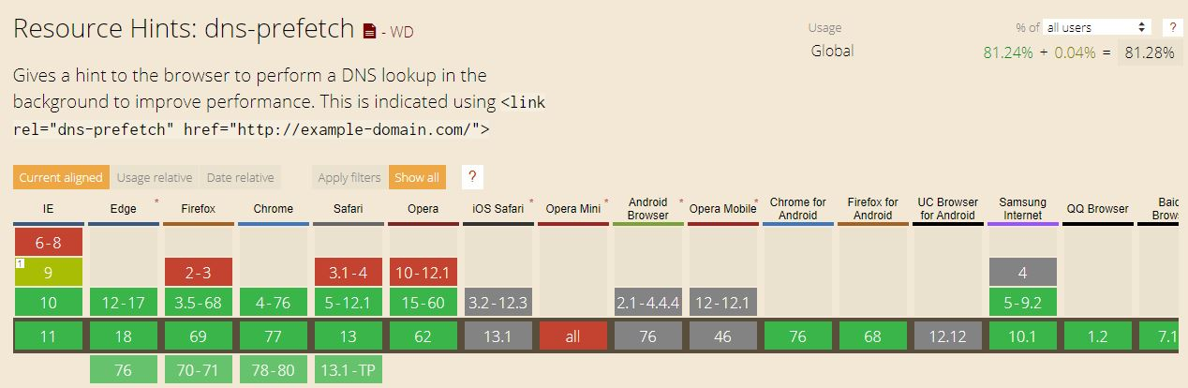
dns-prefetch: caniuse.com – Sept 9, 2019

Slide 18
dns-prefetch: Summary
Use it for domains you will need shortly
Helps with important resources on 3rd party domains the browser does not know about in advance
Use it to slightly speed up some 3rd party script or style
Instructs the browser to schedule DNS resolution for a domain that contains a 3rd party resource on the page that you really need to load sooner

Slide 19
preconnect

Slide 20
What resource hints are there? preconnect
preconnect does all the work necessary to establish a connection with a given domain including the DNS lookup, TCP handshake, and TLS negotiation, if you’re on https.
This hint comes into play when you do not know what specific requests you will be making to a domain, but you do know that you will be requesting resources from that domain.
Use it for domains you will need shortly as the browser incurs the expense of creating a connection with this hint.

Slide 21
preconnect: Benefits
Can mask high-latency connections
Potential savings of several hundred milliseconds, per domain
Connection occurs in the background
Helpful when you know you will be downloading a resource from a domain soon, but you do not know exactly, and you want to speed up the initial connection

Slide 22
preconnect: Be aware of
Setting up and keeping a connection open is costly – both for a client and a server
Use this tag for 4-6 domains at most
The browser is not required to follow a preconnect hint
Pages that use resources must still have <link>’s to those resources

Slide 23
preconnect: How it works
<link rel=“preconnect” href=“//example.com”>
URL Encountered
Cache checked for domain
Cached copy not found
Domain resolved thru DNS request
Connection made
TCP handshake
Domain cached
TLS negotiation
Notes:
Begins the same as the dns-prefetch hint: when the browser encounters these URLs, it first checks its cache, and then, lacking a cached copy, resolves the domain to the associated IP address through a request from the DNS server.
preconnect next performs the TCP handshake and TLS negotiation, if using https, to establish a connection to the domain.
These requests happen in the background in a way that doesn’t block the rendering of the page.

Slide 24




preconnect: Example – JavaScript Issue
JavaScript file makes AJAX requests to api.my-app.com based on user action
api.my-app.com
my-app.com
1
2
Connection to domain occurs at runtime
Notes:
The top row of icons represents the order of execution. Moving from left to right, the website is loaded into the browser and ready for user interaction. JavaScript is then executed that fires off an AJAX request to an unconnected domain. Resolution of the request is delayed while the browser awaits action from the API, which interrupts the user’s experience.
The bottom row of icons represents the actual or perceived performance from the user’s perspective. After the site is loaded in the browser, the user is off to the races. When they trigger the AJAX request to the API, things start to slow down (imagine that needed data is to be returned by the API and the user needs to see that data before deciding what to do next). The slow down is due to the browser having to perform the steps necessary to connect to the API in order to retrieve the data.

Slide 25

preconnect: Example – JavaScript Resolution
JavaScript file makes AJAX requests to api.my-app.com based on user action
api.my-app.com
my-app.com
3
4
1
HTML file
api.my-app.com
2
Connection already made when page was parsed
HTML contains,
<link rel=“preconnect” href=“api.my-app.com” />
Notes:
The top row of icons represents the order of execution. Moving from left to right, the website is loaded into the browser and ready for user interaction. JavaScript is then executed that fires off an AJAX request to an unconnected domain. Resolution of the request is delayed while browser awaits action from the API, which interrupts the user’s experience.
The bottom row of icons represents the actual or perceived performance from the user’s perspective. As the HTML for the page is being parsed, the preconnect hint is encountered causing the browser to initiate a connection to the domain at that time in the background.
After the site is loaded in the browser, the user if off to the races. When then trigger the AJAX request to the API, things do not slow down for the user (imagine that needed data is to be returned by the API and the user needs to see that data before deciding what to do next). Thanks to the connection to the domain already being established at the time of the AJAX call, the user experience is not negatively impacted by the browser having to perform the steps necessary to connect to the API during runtime in order to retrieve the data.

Slide 26
preconnect: 10,000 ft. view, sans preconnecting
landing
page
page
page
CSS file using Google Font, Roboto
CSS file using Google Font, Roboto
page
page
page
CSS file using Google Font, Roboto
page
page
JavaScript file makes AJAX requests to api.my-app.com
JavaScript file makes AJAX requests to api.my-app.com
Notes:
Rotation of shapes is intentional and meant to reinforce the top-down view of a website which I am attempting to portray.
In this scenario, the Roboto font from Google is used in all three processing paths and appears in the leading page of all three paths.
The call to api.my-app.com occurs in two of the paths and always with the last page.

Slide 27
preconnect: 10,000 ft. view, with preconnecting
landing
page
page
page
CSS file using Google Font, Roboto
HTML contains,
<link rel=“dns-prefetch” href=“api.my-app.com” />
<link rel=“preconnect” href=“fonts.googleapis.com” />
<link rel=“preconnect” href=“fonts.gstatic.com” />
JavaScript file makes AJAX requests to api.my-app.com
page
page
page
page
page
CSS file using Google Font, Roboto
JavaScript file makes AJAX requests to api.my-app.com
CSS file using Google Font, Roboto
Notes:
Rotation of shapes is intentional and meant to reinforce the top-down view of a website which I am attempting to portray.
The landing page aids the performance of all three of its child processing paths by kicking off the connections to the two Google Fonts domains ahead of the user navigating to those pages.
The landing page does not use any of the resources it prefetches, but triggering the connections of these domains does not impact it as the work is being done in the background. When the user navigates away from this page, work has already been started on connection to the resources that will be consumed by subsequent pages.

Slide 28
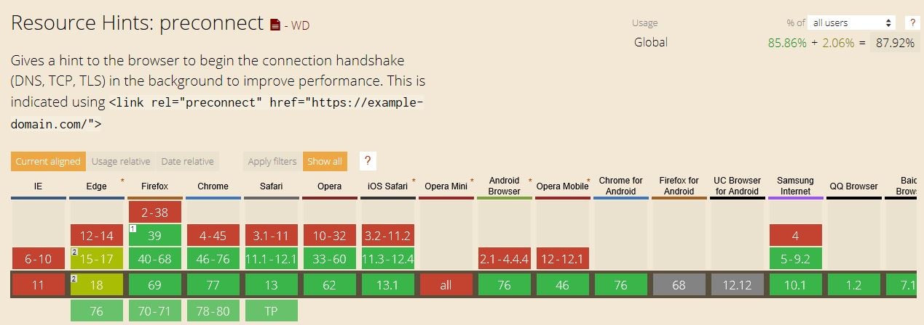
preconnect: caniuse.com – Oct. 22, 2019

Slide 29
preconnect: Summary
For domains you will need in short time
Even if the full resource URL is unknown
Slightly speed up some 3rd party script or style
Notes:
If you have a third-party resource in the page that you really need to load sooner, add <link rel="preconnect" /> for that domain; it will instruct the browser to setup connection for that domain sooner.

Slide 30
dns-prefetch & preconnect
Wonder twin powers activate!

Slide 31
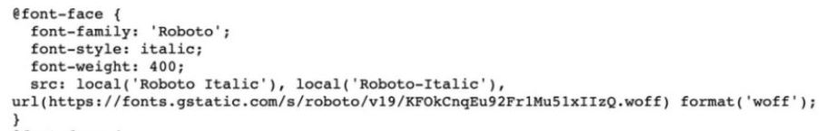
dns-prefetch & preconnect: Example – Google Fonts Issue part I
my-app.com
Local DNS cache
fonts.googleapis.com
DNS resolution will occur late
4
DNS Resolution
landing page
1
Local DNS cache
fonts.googleapis.com
3
5
child page
fonts.googleapis.com
2
6
7
page contains
<link rel="stylesheet"> href="https://fonts.googleapis.com/css?family=Roboto:400,400i,700"
9
8
Notes:
In this simple scenario, we have two pages: a landing page and a secondary page. The secondary page is accessed from the landing page and the conversion percentage is low.
Initially, Google Fonts loads a stylesheet of @font-face declarations for all requested font variants. Each @font-face declaration tells the browser to use a local version of the font, if available, before attempting to download the file from fonts.gstatic.com
Here, the DNS resolution and overarching connection processing is completed in sequence: first, fonts.googleapis.com, second, fonts.gstatic.com.

Slide 32

dns-prefetch & preconnect: Example – Google Fonts Issue part II
This connection will occur even later
my-app.com
child page now contains,
@font-face {…
url(https://fonts.gstatic.com)..}
fonts.gstatic.com
1
landing page
3
2
WOFF file
Notes:
The second stage involves CSS file requests to fonts.gstatic.com for each font variant specified. One additional request is made for each font variant.
The problem with these additional requests is that the browser won’t begin the processes to make them until the initial request to https://fonts.googleapis.com/css is complete.

Slide 33

dns-prefetch & preconnect: Example – Google Fonts Resolution
my-app.com
DNS resolution occurs during parsing of HTML
Local DNS cache
fonts.googleapis.com
landing page
fonts.googleapis.com
1
2
HTML contains,
<link rel=“dns-prefetch” href=“fonts.googleapis.com” />
3
child page using Google Font, Roboto
fonts.gstatic.com
Connection occurs during parsing of HTML
HTML contains,
<link rel=“preconnect” href=“fonts.gstatic.com” />
Notes:
DNS prefetching allows the browser to start the connection to the fonts.googleapis.com domain in the background as soon as the landing page begins to load. This means that by the time the browser is ready to make a request to that domain, some of the work is already done. When the child page loads, its <link> to fonts.googleapis.com initiates a connection to the domain, per usual, but the landing page has already done some of the work for it.
Because we know the next page will be employing the Roboto font, we include a <link rel=“preconnect” href=“fonts.gstatic.com”> statement to that domain because we know that connection is forthcoming, but the browser does not know this initially. Therefore, our second hint further expediates rendering of the next page.

Slide 34
prefetch
Notes:
Now we move from the domain-specific resource hints to the resource-specific hints.

Slide 35
What resource hints are there? prefetch
prefetch asks the browser to download and cache a resource (i.e. script, stylesheet, image, etc.) in the background. Once the current web page has finished loading and the idle time has passed, the browser begins downloading other resources
There is no same-origin restriction for link prefetching. Limiting prefetching to only URLs from the same server would not offer any increased browser security.
The browser doesn’t do anything with the resource after downloading it. Scripts are not executed, stylesheets are not applied. It is just cached – so that when something else needs it, it is available immediately

Slide 36
prefetch: Benefits
Preemptively loads assets for subsequent pages
Loads with lowest priority on current page
HTTPS content can be prefetched

Slide 37
prefetch: Be aware of
No same-origin restriction for link prefetching
The browser is not required to follow the prefetch hint
Set the as attribute
Browsers will use this attribute to determine the resource’s priority
Only cacheable elements should be prefetched – anchor (<a>) tags are not prefetched
Mobile users
User data restrictions could apply – possibly costing them money
Do not use for urgently needed assets on current page
Notes:
As the browser is not required to follow this hint, it is important to still have a link to required assets on the pages that will consume them, per usual.

Slide 38
prefetch: How it works
<link rel=“prefetch” href=“/library.js” as=“script”>
Current page
Asset downloaded as low priority
Asset cached
Script are not executed yet
Subsequent page
Scripts are executed now
Styles are not applied yet
Styles are applied now
Notes:
The download happens with a low priority, so it doesn’t interfere with more important resources on the current page.
The browser doesn’t do anything with the resource after downloading it. Scripts aren’t executed, stylesheets aren’t applied. It’s just cached – so that when something else needs it, it’s available immediately.

Slide 39
prefetch: Resource request sequence: issue
page 1
page 2
page 3
Landing page
Uses PinkFuzzyBunnySlippers image
Uses PinkFuzzyBunnySlippers theme for styling
PinkFuzzyBunnySlippers image downloaded now
PinkFuzzyBunnySlippers CSS downloaded now
Notes:
In this scenario, resources are downloaded by the pages immediately consuming them.

Slide 40
prefetch: Resource request sequence: resolution
HTML contains,
<link rel=“prefetch” href=“my-app.com/images/PFBS.jpg” as=“image” />
HTML contains,
<link rel=“prefetch” href=“my-app.com/styles/PFBS.css” as=“style” />
page 1
page 2
page 3
Landing page
Uses PinkFuzzyBunnySlippers image
Uses PinkFuzzyBunnySlippers theme for styling
Notes:
In this sequence, each page that logically precedes another executes a prefetching of resources used by trailing page in order to expediate the loading of the trailing page.

Slide 41
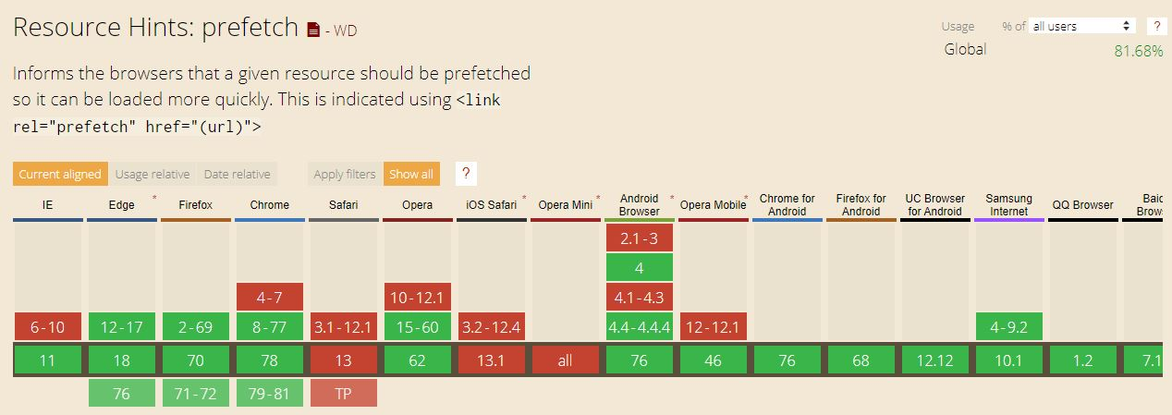
prefetch: caniuse.com – Oct. 28, 2019

Slide 42
prefetch: Summary
For assets used on subsequent pages
Shifts loading time to speed rendering of that page
Not intended for urgently needed assets for current page
Use <link rel=“preload”> instead

Slide 43
preload
Notes:
Now our focus shifts from resources related to subsequent pages to resources need on the current page.

Slide 44
What resource hints are there? preload
preload is used to retrieve a resource that will be needed on the same page the hint is located on. Starting the load early in the page life-cycle ensures resources are available earlier and are less likely to block the page’s render.
preload is a mandatory and high-priority action for a resource that is necessary for the current navigation. It is actually the only mandatory resource hint, so remember, “With great power comes great responsibility”.
Notes:
preload is like prefetch, with the difference that if prefetch is used to initiate a request for a resource that will be needed in a subsequent route, preload is used to prefetch a resource that will be needed in the same page.
Fonts are probably the most important thing that gets hidden in the CSS. They are critical for rendering the text on the page, but they don’t get loaded until the browser is sure that they are going to be used. That check happens only after CSS has been parsed, and applied, and the browser has matched CSS rules to the DOM nodes. This happens late in the page loading process and it often results in an unnecessary delay in text rendering. You can avoid it by using the preload attribute when you link fonts.
The quote is Uncle Ben to Peter Parker.

Slide 45
preload: Benefits
Can jump the gun and start earlier loading of needed resources for the current page as the page is being parsed, such as:
Resources that are pointed to from inside CSS, like fonts or images
Resources that JavaScript can request, like JSON, imported scripts, or web workers
CSS files loaded by JavaScript (Critical CSS approach)
Larger images and video files
Notes:
Per the the Critical CSS approach, you split your CSS into two parts – critical (required for immediate rendering – above the fold content) and non-critical – below the fold. With this approach, non-critical styles will start downloading only when JavaScript starts executing – which can be a few seconds after the first render. Instead of waiting for the JavaScript to execute, use <link rel="preload"> to initiate the download sooner.

Slide 46
preload: Be aware of
It is a hint that is compulsory for the browser
It is specific to the current page
Do not overuse it
Doing so will likely prevent the browser from smartly scheduling everything
Do not confuse with prefetch
Do not use if you do not immediately need a resource after the page loads
Set the as attribute
Browsers will use this attribute to determine the resource’s priority
Notes:
dns-prefetch is the younger brother of preconnect. prefetch is a distant cousin to preload.

Slide 47
preload: How it works
<link rel=“preload” href=“/library.js” as=“script”>
Current page
Resource downloaded early as high priority
Page renders
Resource is preloaded in cache
Still current page
Resource is available when required

Slide 48
preload: Page resource usage: issue
index.html
<head>
<link rel=“stylesheet” href=“style.css” />
</head>
/* style.css */
@font-face {
src: url(“comic-sans.woff2”) format(“woff2”);
}
By default, comic-sans.woff2 will start downloading only when style.css is fetched an applied.
Notes:
<link rel="preload"> will help when you know you’ll need a resource soon after loading the page, and you want to start loading it earlier.
In this case, a custom font is being used. The @font-face rule that applies that font is in an external CSS file.

Slide 49
preload: Page resource usage: resolution
index.html
<head>
<link rel=“preload” href=“comic-sans.woff2” as=“font” />
<link rel=“stylesheet” href=“style.css” />
</head>
Instead of waiting for style.css to be fetched and applied, preload can be used to initiate the download of the font sooner.
/* style.css */
@font-face {
src: url(“comic-sans.woff2”) format(“woff2”);
}

Slide 50
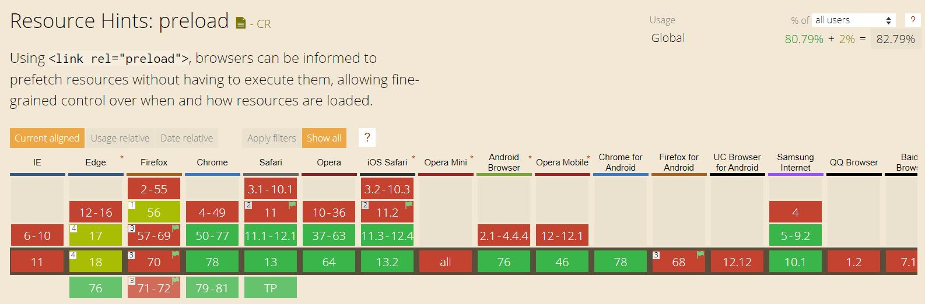
preload: caniuse.com – Oct. 30, 2019

Slide 51
preload: Summary
This is a mandatory, high-priority resource hint
Actually, it is the only hint that is such
Use when you need an asset for the current page – and soon
Allows you to start loading of an asset quicker than normal

Slide 52
prerender

Slide 53
What resource hints are there? prerender
Prerendering asks the browser to load a URL and render it in an invisible tab. When a user clicks on a link to that URL, the page should be rendered immediately. It’s helpful when you’re sure a user will visit a specific page next, and you want to render it faster.
As the browser executes scripts on the pre-rendered page, you may encounter some unexpected consequences such as analytics beacons being fired without the page being displayed. You can use the Page Visibility API to account for these situations.
Be aware that the decision to start the prerender process is left to the browser, and that the browser may choose not to start or to abandon the pre-render off your content based on a set of predefined rules.

Slide 54
prerender: Benefits
Queue up an entire page in the background
Prerendering occurs after the initial page has finished loading

Slide 55
prerender: Be aware of
Not widely supported across browsers
Firefox has an implementation bug which has been open for 7+ years
Analytics beacons can be adversely affected
The Page Visibility API can be used to guard against scripts firing before they're rendered on the user's screen
Should have high degree of confidence that page will be viewed
Pre-rendering a page is very costly – both in terms of traffic and memory
The browser is not required to follow a <link rel=“prerender”> instruction.
Notes:
Despite (or because of?) its power, in 2019, <link rel="prerender"> has poor support in major browsers. Additionally, the browser is not required to follow a <link rel="prerender"> instruction. This means it can decide not to perform the prerender – e.g., if the memory is low, or the connection is slow.

Slide 56
preload: How it works
<link rel=“prerender” href=“https://my-app.com/pricing”>
Current page loading
Next page is loaded by the browser
Next page requested by user
Link to URL is clicked
Next page available
The next page renders immediately

Slide 57
prerender: Page request sequence: issue
page 1
page 2
Landing page
Browser renders page 2, resources are loaded, the DOM is created, stylesheets are applied, and JavaScript is executed. User feels a disturbance in The Force
URL clicked to navigate to page 2
Notes:
In this scenario, individual pages are rendered when they are requested.

Slide 58
prerender: Page request sequence: resolution
page 1
page 2
User clicks URL
Landing page
HTML contains,
<link rel=“prerender” href=“//my-app.com/page2” />
page 2 is rendered immediately. Master Yoda is pleased.
Resources are downloaded, the DOM created, styling applied, JavaScript executed
page 2
Browser renders page in an invisible tab
Notes:
This is the ninja option, as prerender gives us the ability to preemptively load all of the assets of a certain document.
This hint is like opening the URL in a hidden tab – all the resources are downloaded, the DOM is created, the page is laid out, the CSS is applied, the JavaScript is executed. If the user navigates to the specified href, then the hidden page is swapped into view making it appear to load instantly.

Slide 59
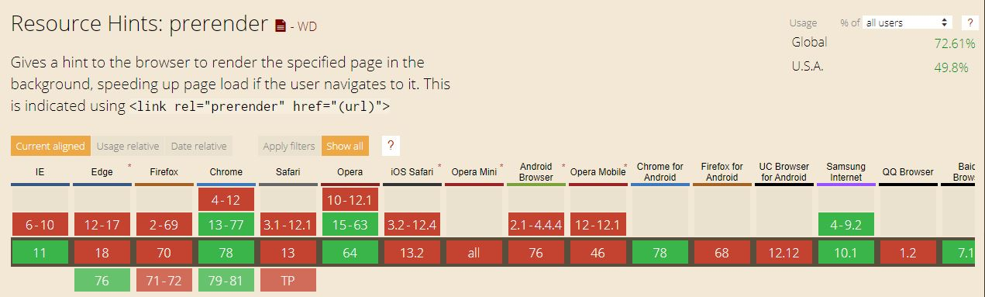
prerender: caniuse.com – Nov. 7, 2019
Notes:
Chrome doesn’t do a full render. Instead of a full render, Chrome makes a NoState Prefetch to save memory.
Firefox and Safari don’t support this tag at all. This doesn’t break the specification, as browsers are not required to act on the tag; but this is still quite sad. Firefox has an implementation bug which has been open for 7 years; and there are reports that state Safari doesn’t support it too.

Slide 60
prerender: Summary
Use when you are really sure a user will got to some page next (and it is supported by targeted browser(s)

Slide 61
3. Hints inside of hints
Notes:
These apply to the page-specific resource hints, prefetch and prerender.

Slide 62
The as Attribute

Slide 63
The as attribute
It helps the browser prioritize and schedule downloads properly by specifying type of content to be preloaded allowing the browser to:
Apply the correct content security policy to the resource
Set the correct Accept request headers for it
Applies to loading of resources for a page, so applies to the prefetch and preload resource hints

Slide 64
The as attribute Possible values
audio: Audio file, as typically used in <audio>
document: An HTML document intended to be embedded by a <frame> or <iframe>
embed: A resource to be embedded inside an <embed> element
fetch: Resource to be accessed by a fetch or XHR request, such as an ArrayBuffer or JSON file
font: Font file
image: Image file
object: A resource to be embedded inside an <object> element
script: JavaScript file
style: CSS stylesheet
track: WebVTT file
worker: A JavaScript web worker or shared worker
video: Video file, as typically used in <video>
Notes:
https://developer.mozilla.org/en-US/docs/Web/HTML/Preloading_content#What_types_of_content_can_be_preloaded
The full list of values the as attribute can take is governed by the Fetch spec — see request destinations.

Slide 65
The as attribute Examples
<link rel="prefetch" href="/style.css" as="style" />
<link rel="preload" href="comic-sans.woff2" as="font" />
<link rel="preload" href="main.js" as="script">

Slide 66
The pr Attribute
Notes:
“pr”stands for “probability”

Slide 67
The pr attribute
Used to indicate the probability a given resource will be necessary
Can be used with every resource hint except preload
In a resource-constrained device, the browser may decide to only execute high probability hints
expects a float value in the [0.0-1.0] range
Code example <link rel="prerender" href="//example.com/next-page.html" pr="0.75">
Notes:
Allows you to rank resources against each other.

Slide 68
The type Attribute

Slide 69
The type attribute
<link> elements can accept a type attribute, which contains the MIME type of the resource the element points to
The browser will use the type attribute value to work out if it supports that resource, and will only download it if so, ignoring it if not

Slide 70
The type attribute Code example
<head>
<meta charset="utf-8">
<title>Video preload example</title>
<link rel="preload" href="me.mp4" as="video" type="video/mp4">
</head>
<body>
<video controls>
<source src="me.mp4" type="video/mp4">
<source src="me.webm" type="video/webm">
<p>Your browser doesn't support HTML5 video. Here is a <a href="me.mp4">link to the video</a> instead.</p>
</video>
</body>
Notes:
https://developer.mozilla.org/en-US/docs/Web/HTML/Preloading_content#Including_a_MIME_type
So in this case, browsers that support MP4s will preload and use the MP4, making the video player, hopefully, smoother/more responsive for users. Browsers that don't support MP4 can still load the WebM version, but don't get the advantages of preloading. This shows how preloading content can be combined with the philosophy of progressive enhancement.
The MP4 appears twice – once in the preload hint and once in the <video> element – as a safeguard for browsers that do not support the preload hint, which would disregard the <link> element.

Slide 71
4. When to use resource hints

Slide 72
When to use resource hints?
As developers, we know our websites better than the browser does
We can use our knowledge to inform the browser about core resources to expedite downloading of those resources
Questions to ask yourself and your team are:
Which are the most critical resources on each page?
What actions trigger the download of additional content?
Which assets are on the critical rendering path?
Which are the most visited pages?
What is the journey your users take to conversion?
What is the frequency of a certain action?
Notes:
The benefit of resource hints is that we know what the future can hold for visitors of our websites. The browser knows only what it is building right now.

Slide 73

When to use resource hints?
The greatest requirement for their use is…
Notes:
We have to be willing to invest the time to understand our websites and how visitors interact with them.
We need to understand the spirit of the law behind the letter of the law we have written.

Slide 74
Contact info and helpful links

Slide 75
I am Tony Mangino
Email me at tm13089@gmail.com
This PowerPoint is on GitHub at https://github.com/TonyMangino/html-resource-hints.git
Find me on LinkedIn at www.linkedin.com/in/tonymangino

Slide 76
Helpful links used while researching
https://3perf.com/blog/link-rels/
https://medium.com/@luisvieira_gmr/html5-prefetch-1e54f6dda15d
https://css-tricks.com/prefetching-preloading-prebrowsing/
https://developer.mozilla.org/en-US/docs/Web/HTML/Preloading_content#What_types_of_content_can_be_preloaded
https://www.smashingmagazine.com/2019/06/optimizing-google-fonts-performance/

Slide 77


